Slide 1


3rd
Lipschitz-Certifiable Training with a Tight Outer Bound
(Local Lipschitz Constant )
Sungyoon Lee, Jaewook Lee, Saerom Park
Seoul National University
NIPS 2020

Slide 2
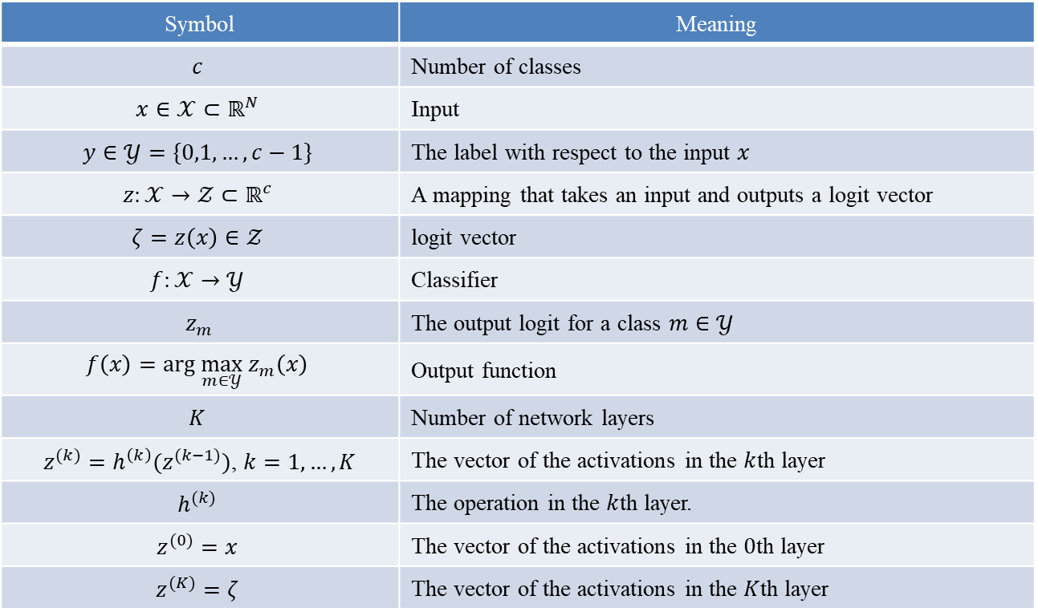
Lipschitz Constant
Notation
Symbol | Meaning
$$c$$ | Number of classes
$$x∈𝒳⊂ℝ^{N}$$ | Input
$$y∈𝒴=\{0,1,…,c−1\}$$ | The label with respect to the input $x$
$$z:𝒳→𝒵⊂ℝ^{c}$$ | A mapping that takes an input and outputs a logit vector
$$ζ=z\left(x\right)∈𝒵$$ | logit vector
$$f:𝒳→𝒴$$ | Classifier
$z_{m}$ | The output logit for a class $m∈𝒴$
$$f\left(x\right)=arg \max_{m∈𝒴} z_{m}\left(x\right)$$ | Output function
$$K$$ | Number of network layers
$z^{(k)}=h^{\left(k\right)}(z^{(k−1)})$, $k=1,…,K$ | The vector of the activations in the $k$th layer
$$h^{(k)}$$ | The operation in the $k$th layer.
$$z^{(0)}=x$$ | The vector of the activations in the $0$th layer
$$z^{(K)}=ζ$$ | The vector of the activations in the $K$th layer
Sungyoon Lee, Jaewook Lee, Saerom Park. Lipschitz-Certifiable Training with a Tight Outer Bound. NIPS. 2020.

Slide 3
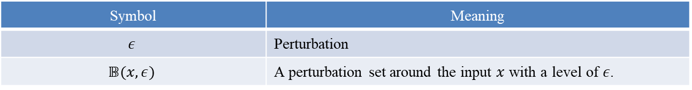


Lipschitz Constant
Certifiable Training
Symbol | Meaning
$$ε$$ | Perturbation
$$𝔹(x,ε)$$ | A perturbation set around the input $x$ with a level of $ε$.
The robust classification error within the perturbation set $𝔹(∙,ε)$ on a data distribution $D$ is defined as
Robust Training
Goal of certifiable training: minimize the robust classification error $R(f)$.
Challenge: exact verification for $R(f)$ is NP-complete (Fsat-Lip里也有讲)
Solution: use a surrogate of $R(f)$ to construct the objective of certifiable training.
Difference between Adversarial training and Certifiable training
Adversarial training: minimizes a lower bound on $R(f)$
Certifiable training: minimizes an upper bound on $R(f)$ that builds a certificate of robustness
$$R\left(f\right)=ℙ_{D}[∃x^{′}∈𝔹\left(x,ε\right) s.t.f(x′)≠y]$$
Sungyoon Lee, Jaewook Lee, Saerom Park. Lipschitz-Certifiable Training with a Tight Outer Bound. NIPS. 2020.

Slide 4
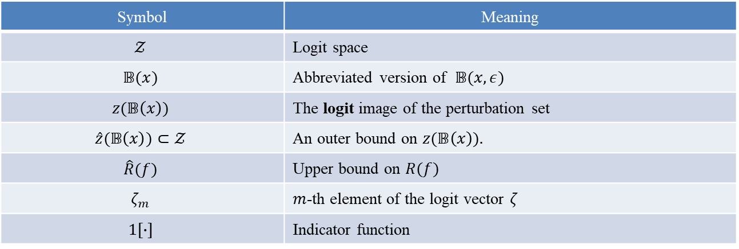

Lipschitz Constant
Certifiable Training
Symbol | Meaning
$$𝒵$$ | Logit space
$$𝔹(x)$$ | Abbreviated version of $𝔹(x,ε)$
$$z(𝔹\left(x\right))$$ | The logit image of the perturbation set
$$\hat{z}(𝔹\left(x\right))⊂𝒵$$ | An outer bound on $z(𝔹\left(x\right)).$
$$\hat{R}(f)$$ | Upper bound on $R(f)$
$$ζ_{m}$$ | $m$-th element of the logit vector $ζ$
$$1[∙]$$ | Indicator function
Construct the upper bound $\hat{R}(f)$ on $R(f)$: 分类误差上限
$$R\left(f\right)=𝔼_{\left(x,y\right)\sim D}\left[\max_{ζ∈z\left(𝔹\left(x\right)\right)}{\max_{y^{′}≠y}{1\left[ \left(ζ_{y}−ζ_{y^{′}}\right)≤0 \right]}}\right]≤𝔼_{\left(x,y\right)\sim D}\left[\max_{ζ∈\hat{z}\left(𝔹\left(x\right)\right)}{\max_{y^{′}≠y}{1\left[ \left(ζ_{y}−ζ_{y^{′}}\right)≤0 \right]}}\right]=\hat{R}(f)$$
(1)
Sungyoon Lee, Jaewook Lee, Saerom Park. Lipschitz-Certifiable Training with a Tight Outer Bound. NIPS. 2020.

Slide 5
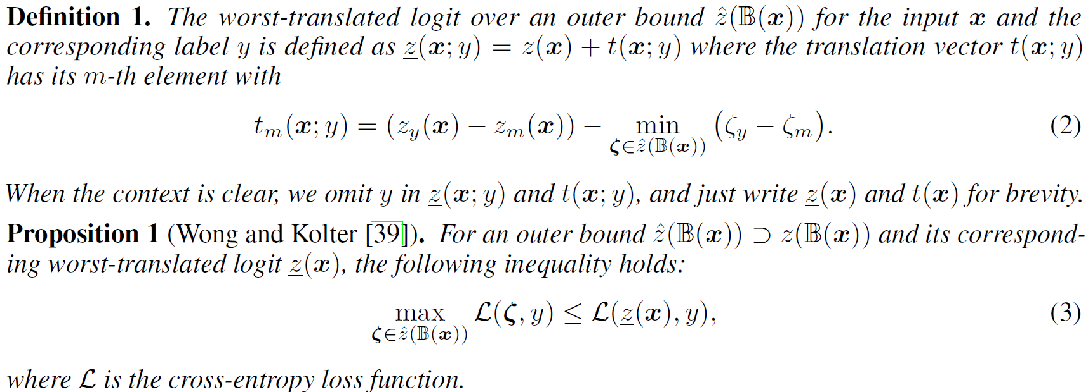


Lipschitz Constant
Certifiable Training
Symbol | Meaning
$$L$$ | Cross-entropy loss
$$\underline{z}(x)$$ | The worst-translated logit
Worst-Translated Logit
Objective for verifiable training: $𝔼_{\left(x,y\right)\sim D}\left[\max_{ζ∈\hat{z}\left(𝔹\left(x\right)\right)}{L(ζ,y)}\right]$
The worst-translated logit $\underline{z}(x)$ can provide an upper bound on the cross-entropy loss over an outer bound $\hat{z}(𝔹\left(x\right))$ : $\underline{z}(x)$ may not be inside the $\hat{z}(𝔹\left(x\right))$.
Sungyoon Lee, Jaewook Lee, Saerom Park. Lipschitz-Certifiable Training with a Tight Outer Bound. NIPS. 2020.
Notes:
定义 1. 输入 x 和对应标签 y 的外界 ^z(B(x)) 上的最差转换 logit 定义为 z(x; y) = z(x) + t(x; y) 其中平移向量 t(x; y) 的第 m 个元素为

Slide 6



Lipschitz Constant
Certifiable Training
Upper bound on the cross-entropy loss over an outer bound $\hat{z}(𝔹\left(x\right))$
The objective:
Verification error of the model $f$ on the test data $D_{test}$:
$$J\left(f,D\right)=𝔼_{\left(x,y\right)\sim D}[L(\underline{z}\left(x\right),y)]$$
(4)
$$R_{V}\left(f\right)={\hat{ℙ}}_{\left(x,y\right)\sim D_{test}}[\min_{y^{′}≠y}\left({\underline{z}}_{y}\left(x\right)−{\underline{z}}_{y^{′}}\left(x\right)\right)≤0]$$
(5)
Sungyoon Lee, Jaewook Lee, Saerom Park. Lipschitz-Certifiable Training with a Tight Outer Bound. NIPS. 2020.

Slide 7

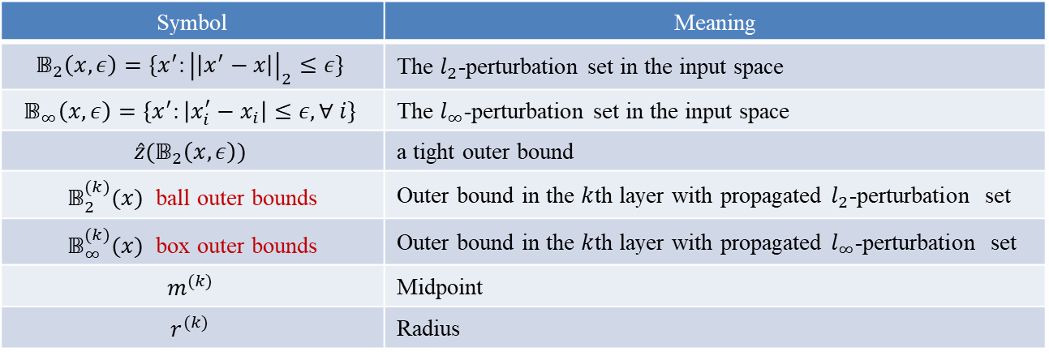
Lipschitz Constant
Lipschitz-Certifiable Training
How to Calculate the Worst-translated Logit
Propose A Tight Outer Bound Estimation
Propose An Efficient Algorithm
The $k$th layer $l_{∞}$ bound can be represented as the box constraint:
Symbol | Meaning
$$𝔹_{2}\left(x,ε\right)=\{x^{′}:{\left|\left|x^{′}−x\right|\right|}_{2}≤ε\}$$ | The $l_{2}$-perturbation set in the input space
$$𝔹_{∞}\left(x,ε\right)=\{x^{′}:\left|x_{i}^{′}−x_{i}\right|≤ε, ∀ i\}$$ | The $l_{∞}$-perturbation set in the input space
$$\hat{z}(𝔹_{2}\left(x,ε\right))$$ | a tight outer bound
$𝔹_{2}^{(k)}(x)$ ball outer bounds | Outer bound in the $k$th layer with propagated $l_{2}$-perturbation set
$𝔹_{∞}^{(k)}(x)$ box outer bounds | Outer bound in the $k$th layer with propagated $l_{∞}$-perturbation set
$$m^{(k)}$$ | Midpoint
$$r^{(k)}$$ | Radius
$$𝔹_{∞}^{(k)}=midrad \left(m^{\left(k\right)},r^{\left(k\right)}\right)≡\{p:\left|p_{i}−m_{i}^{\left(k\right)}\right|≤r_{i}^{\left(k\right)},∀ i\}$$
Sungyoon Lee, Jaewook Lee, Saerom Park. Lipschitz-Certifiable Training with a Tight Outer Bound. NIPS. 2020.

Slide 8





Lipschitz Constant
Lipschitz-Certifiable Training
Outer Bound Estimation
Construct the outer bound from $l_{2}$-perturbation $\hat{z}(𝔹_{2}\left(x,ε\right))$
基础方法：Global Lipschitz Constant $L$ of the logit function $z$: is efficiently computed as the product of all layer-wise Lipschitz constants.
改进目标：Tighten the spherical (圆形) outer bound in the logit space
已有改进方法：Replace it with the ellipsoidal (椭圆形) outer bound
$$L=ε\sum_{i=1}^{k}{L^{(k)}}$$
$$\hat{z}\left(𝔹_{2}\left(x,ε\right)\right)=𝔹_{2}\left(z(x),εL\right)$$
$$ρ^{(k)}=ε\prod_{i=1}^{k}{L^{(i)}}$$
$$\hat{z}\left(𝔹_{2}\left(x,ε\right)\right)=h^{(K)}𝔹_{2}\left(z^{\left(K−1\right)},ρ^{(K−1)}\right)$$
Sungyoon Lee, Jaewook Lee, Saerom Park. Lipschitz-Certifiable Training with a Tight Outer Bound. NIPS. 2020.

Slide 9
Lipschitz Constant
Lipschitz-Certifiable Training
Outer Bound Estimation
存在不足
Global Lipschitz constant
overestimate the outer bound and impose a strong penalty for it, limiting the expressiveness of the model.
leads to a poor classification performance, not getting sharp transitions near decision boundary.
Local Lipschitz constants
computationally infeasible to be integrated into the training loop for medium-sized networks,
limited to 2-layered networks.
本文改进目标： Tighten the ellipsoidal (椭圆形) outer bound in the logit space
本文改进方法： Box Constraint Propagation (BCP), using layer-wise propagation with the Lipschitz constant and interval arithmetic to approximate the propagation of the perturbation set.
Sungyoon Lee, Jaewook Lee, Saerom Park. Lipschitz-Certifiable Training with a Tight Outer Bound. NIPS. 2020.

Slide 10

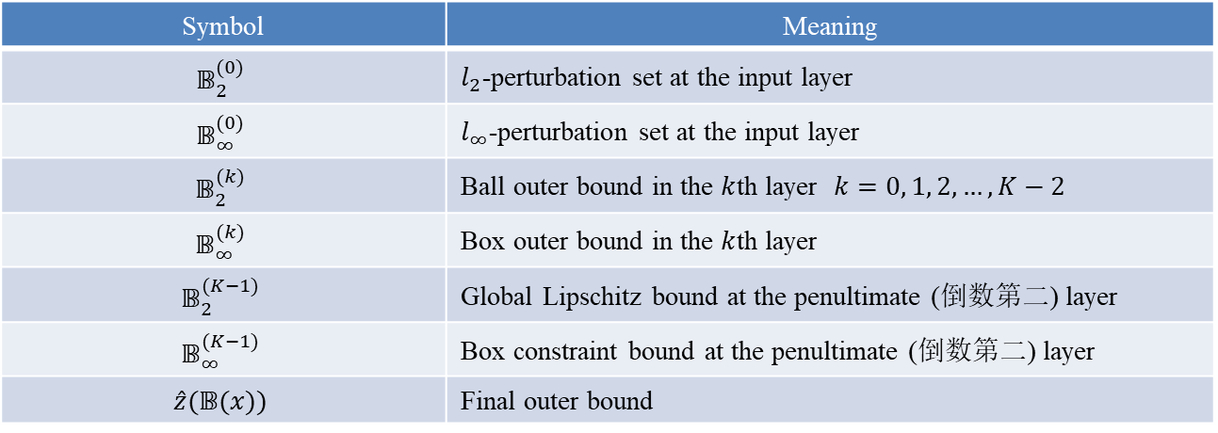
Lipschitz Constant
Lipschitz-Certifiable Training
Outer Bound Estimation
BCP workflow
$𝔹_{2}^{(k)}$ is the Lipschitz outer bound $𝔹_{2}(z^{\left(k\right)},ρ^{(k)})$
$𝔹_{∞}^{(k)}$ is obtained by two box constraints
one constrains the propagated ellipse image $h^{(k+1)}𝔹_{2}^{(k)}$ of ball $𝔹_{2}^{(k)}$
another constrains the propagated parallelepiped image $h^{(k+1)}𝔹_{∞}^{(k)}$of box $𝔹_{∞}^{(k)}$
Symbol | Meaning
$$𝔹_{2}^{(0)}$$ | $l_{2}$-perturbation set at the input layer
$$𝔹_{∞}^{(0)}$$ | $l_{∞}$-perturbation set at the input layer
$$𝔹_{2}^{(k)}$$ | Ball outer bound in the $k$th layer $k=0, 1, 2, …,K−2$
$$𝔹_{∞}^{(k)}$$ | Box outer bound in the $k$th layer
$$𝔹_{2}^{(K−1)}$$ | Global Lipschitz bound at the penultimate (倒数第二) layer
$$𝔹_{∞}^{(K−1)}$$ | Box constraint bound at the penultimate (倒数第二) layer
$$\hat{z}(𝔹(x))$$ | Final outer bound
Sungyoon Lee, Jaewook Lee, Saerom Park. Lipschitz-Certifiable Training with a Tight Outer Bound. NIPS. 2020.

Slide 11
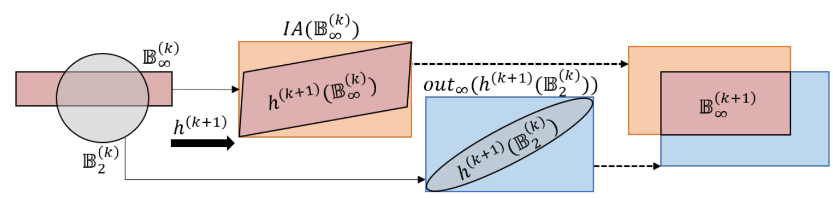
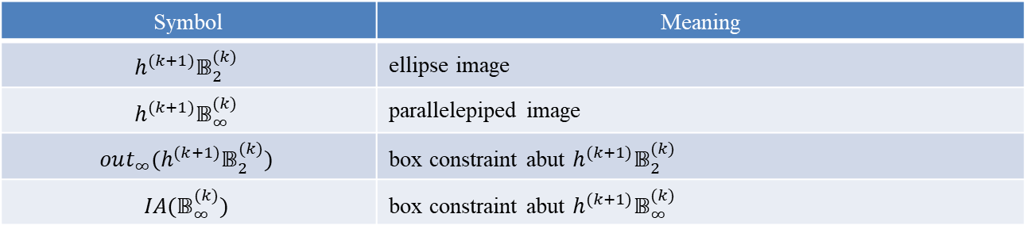
Lipschitz Constant
Lipschitz-Certifiable Training
Outer Bound Estimation
BCP workflow
Symbol | Meaning
$$h^{(k+1)}𝔹_{2}^{(k)}$$ | ellipse image
$$h^{(k+1)}𝔹_{∞}^{(k)}$$ | parallelepiped image
$$out_{∞}(h^{(k+1)}𝔹_{2}^{(k)})$$ | box constraint abut $h^{(k+1)}𝔹_{2}^{(k)}$
$$IA(𝔹_{∞}^{(k)})$$ | box constraint abut $h^{(k+1)}𝔹_{∞}^{(k)}$
Figure 1
Sungyoon Lee, Jaewook Lee, Saerom Park. Lipschitz-Certifiable Training with a Tight Outer Bound. NIPS. 2020.

Slide 12

Lipschitz Constant
Lipschitz-Certifiable Training
Outer Bound Estimation
BCP workflow
Box constraint abut $h^{(k+1)}𝔹_{2}^{(k)}$
Box constraint abut $h^{(k+1)}𝔹_{∞}^{(k)}$
(6)
Figure 1
Sungyoon Lee, Jaewook Lee, Saerom Park. Lipschitz-Certifiable Training with a Tight Outer Bound. NIPS. 2020.

Slide 13


Lipschitz Constant
Lipschitz-Certifiable Training
Outer Bound Estimation
BCP workflow
两个盒约束下的box outer bound $𝔹_{∞}^{(k+1)}=out_{∞}(h^{(k+1)}𝔹_{2}^{(k)})⋂IA(𝔹_{∞}^{(k)})$
中间层outer bound： ($𝔹_{2}^{(k)},𝔹_{∞}^{(k)}$) pair ($k=0,1, 2, …,K−2$)
倒数第二层outer bound ： $𝔹_{∞}^{(K−1)}⋂𝔹_{2}^{(K−1)}$
最后一层outer bound ： $\hat{z}\left(𝔹\left(x\right)\right)=h^{\left(K\right)}(𝔹_{∞}^{(K−1)}⋂𝔹_{2}^{(K−1)})$
$$m^{(k+1)}=\frac{(ub^{\left(k+1\right)}+lb^{(k+1)})}{2}$$
$$r^{(k+1)}=\frac{(ub^{\left(k+1\right)}−lb^{(k+1)})}{2}$$
s.t. $ub^{\left(k+1\right)}=\max{({\hat{m}}^{\left(k\right)}+{\hat{r}}^{\left(k\right)},{\tilde{m}}^{\left(k\right)}+{\tilde{r}}^{\left(k\right)})}$
$$lb^{\left(k+1\right)}=\min{({\hat{m}}^{\left(k\right)}−{\hat{r}}^{\left(k\right)},{\tilde{m}}^{\left(k\right)}−{\tilde{r}}^{\left(k\right)})}$$
Sungyoon Lee, Jaewook Lee, Saerom Park. Lipschitz-Certifiable Training with a Tight Outer Bound. NIPS. 2020.

Slide 14

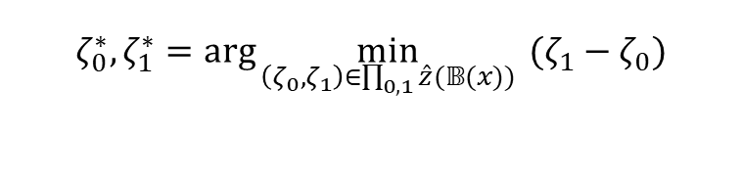

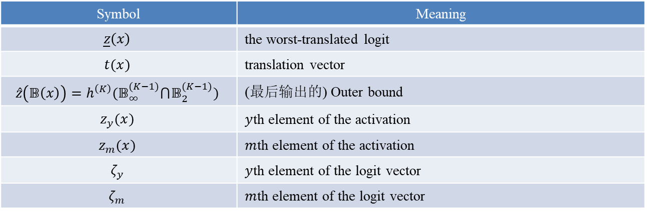
Lipschitz Constant
Lipschitz-Certifiable Training
Certifiable Training Algorithm
Aim: minimize the objective $J\left(f,D\right)$ in (4)
Assume $m=0$, $y=1$
Symbol | Meaning
$$\underline{z}\left(x\right)$$ | the worst-translated logit
$$t(x)$$ | translation vector
$$\hat{z}\left(𝔹\left(x\right)\right)=h^{\left(K\right)}(𝔹_{∞}^{(K−1)}⋂𝔹_{2}^{(K−1)})$$ | (最后输出的) Outer bound
$$z_{y}(x)$$ | $y$th element of the activation
$$z_{m}(x)$$ | $m$th element of the activation
$$ζ_{y}$$ | $y$th element of the logit vector
$$ζ_{m}$$ | $m$th element of the logit vector
$$J\left(f,D\right)=𝔼_{\left(x,y\right)\sim D}[L(\underline{z}\left(x\right),y)]$$
$$ζ_{0}^{∗},ζ_{1}^{∗}=\arg{\min_{\left(ζ_{0},ζ_{1}\right)∈\prod_{0,1}{\hat{z}(𝔹(x))}}{ (ζ_{1}−ζ_{0})}}$$
Sungyoon Lee, Jaewook Lee, Saerom Park. Lipschitz-Certifiable Training with a Tight Outer Bound. NIPS. 2020.

Slide 15
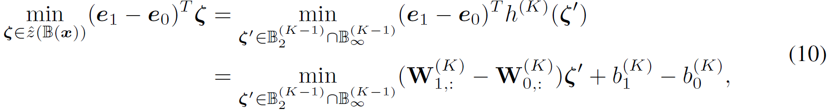
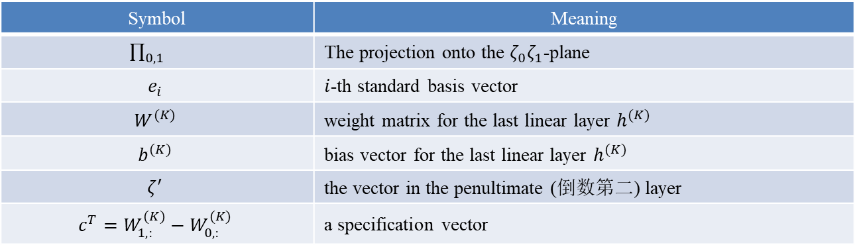
Lipschitz Constant
Lipschitz-Certifiable Training
Certifiable Training Algorithm
Optimization
Find the largest violation of the specification (违规) to verify the network
Symbol | Meaning
$\prod_{0,1}{}$ | The projection onto the $ζ_{0}ζ_{1}$-plane
$$e_{i}$$ | $i$-th standard basis vector
$$W^{(K)}$$ | weight matrix for the last linear layer $h^{(K)}$
$$b^{(K)}$$ | bias vector for the last linear layer $h^{(K)}$
$$ζ^{′}$$ | the vector in the penultimate (倒数第二) layer
$$c^{T}=W_{1,:}^{(K)}−W_{0,:}^{(K)}$$ | a specification vector
Sungyoon Lee, Jaewook Lee, Saerom Park. Lipschitz-Certifiable Training with a Tight Outer Bound. NIPS. 2020.

Slide 16
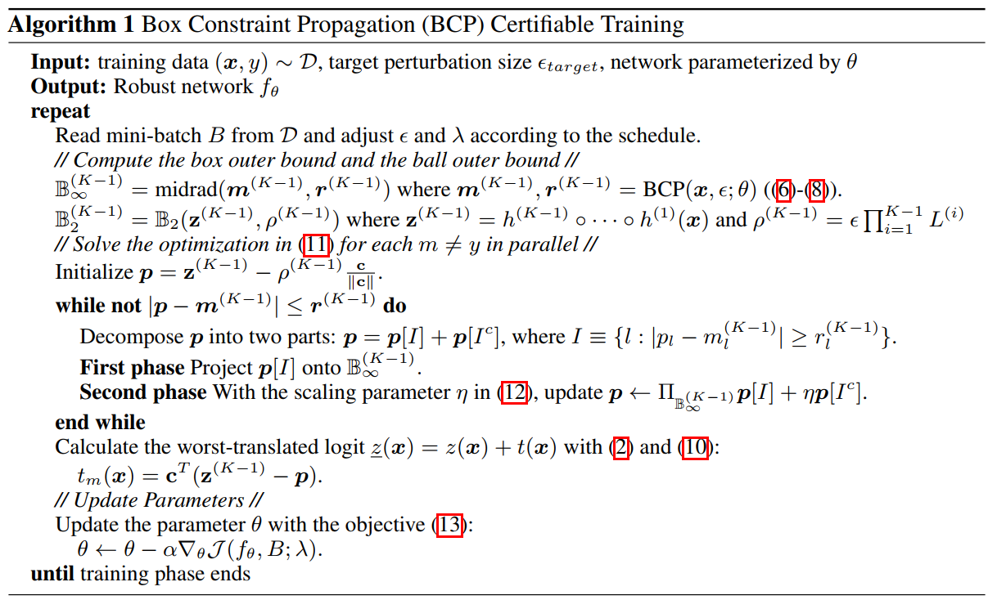
Lipschitz Constant
Lipschitz-Certifiable Training
Certifiable Training Algorithm
Sungyoon Lee, Jaewook Lee, Saerom Park. Lipschitz-Certifiable Training with a Tight Outer Bound. NIPS. 2020.

Slide 17
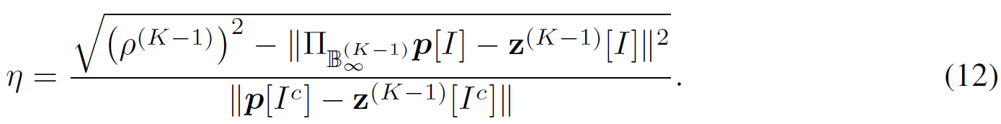

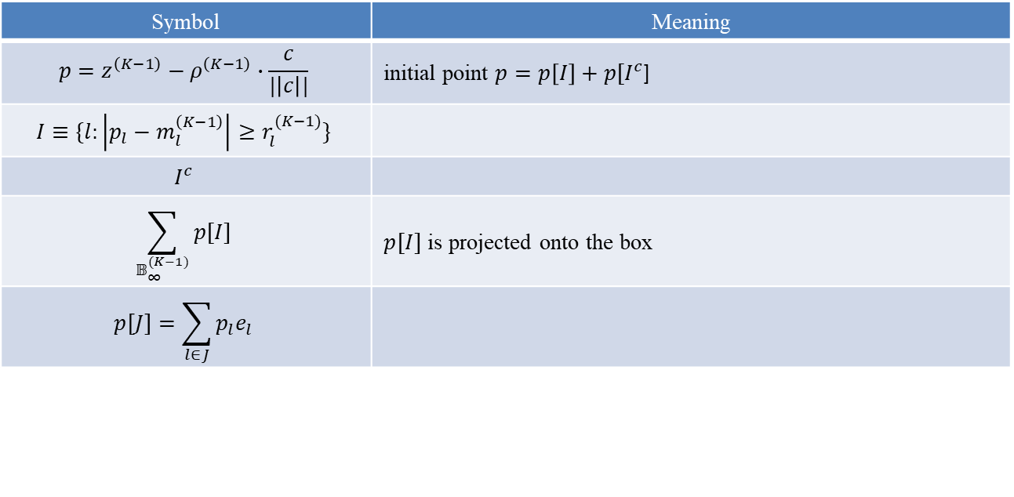
Lipschitz Constant
Lipschitz-Certifiable Training
Certifiable Training Algorithm
$p[I^{c}]$ is scaled with an adaptive parameter $η≥1$
Train on a mixture of normal logit $z(x)$and the worst $\underline{z}\left(x\right)$:
Symbol | Meaning
$$p=z^{\left(K−1\right)}−ρ^{\left(K−1\right)}∙\frac{c}{|\left|c\right||}$$ | initial point $p=p\left[I\right]+p[I^{c}$]
$$I≡\{l:\left|p_{l}−m_{l}^{\left(K−1\right)}\right|≥r_{l}^{(K−1)}\}$$
$$I^{c}$$
$$\sum_{𝔹_{∞}^{(K−1)}}{p[I]}$$ | $p[I]$ is projected onto the box
$$p\left[J\right]=\sum_{l∈J}{p_{l}e_{l}}$$
Sungyoon Lee, Jaewook Lee, Saerom Park. Lipschitz-Certifiable Training with a Tight Outer Bound. NIPS. 2020.

Slide 18
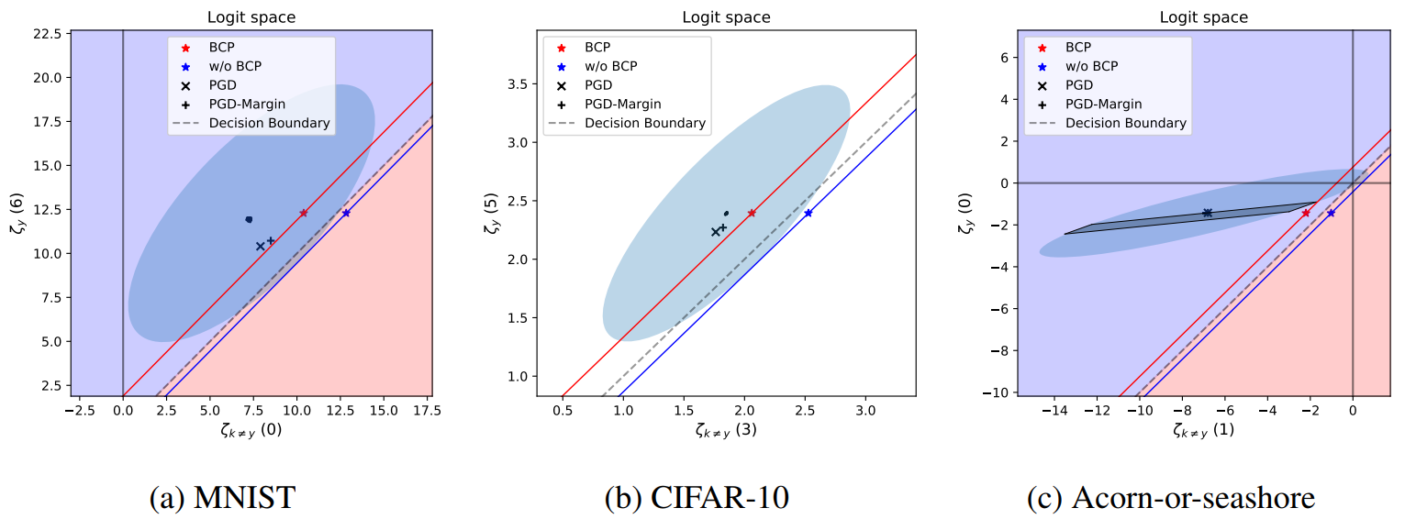
Lipschitz Constant
Experiment 1
Illustration of the outer bounds for the BCP trained models on (a) MNIST, (b) CIFAR-10, and (c) Acorn-or-seashore classification tasks.
BCP cuts off the lower area under the red line from the elliptic area and tightens the outer bound.
The shaded parallelogram area in (c) indicates the image of the feasible region for the box constraint after the last linear layer.
Figure 2
Sungyoon Lee, Jaewook Lee, Saerom Park. Lipschitz-Certifiable Training with a Tight Outer Bound. NIPS. 2020.

Slide 19
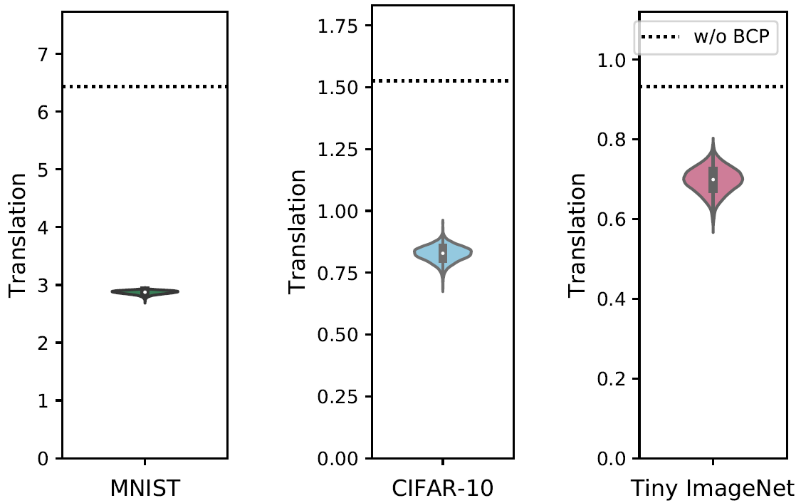
Lipschitz Constant
Experiment 2
Violin plots of the tightness of the outer bounds.
The dotted lines indicate the tightness without BCP. A smaller value indicates a better tightness
Figure 3
Sungyoon Lee, Jaewook Lee, Saerom Park. Lipschitz-Certifiable Training with a Tight Outer Bound. NIPS. 2020.

Slide 20
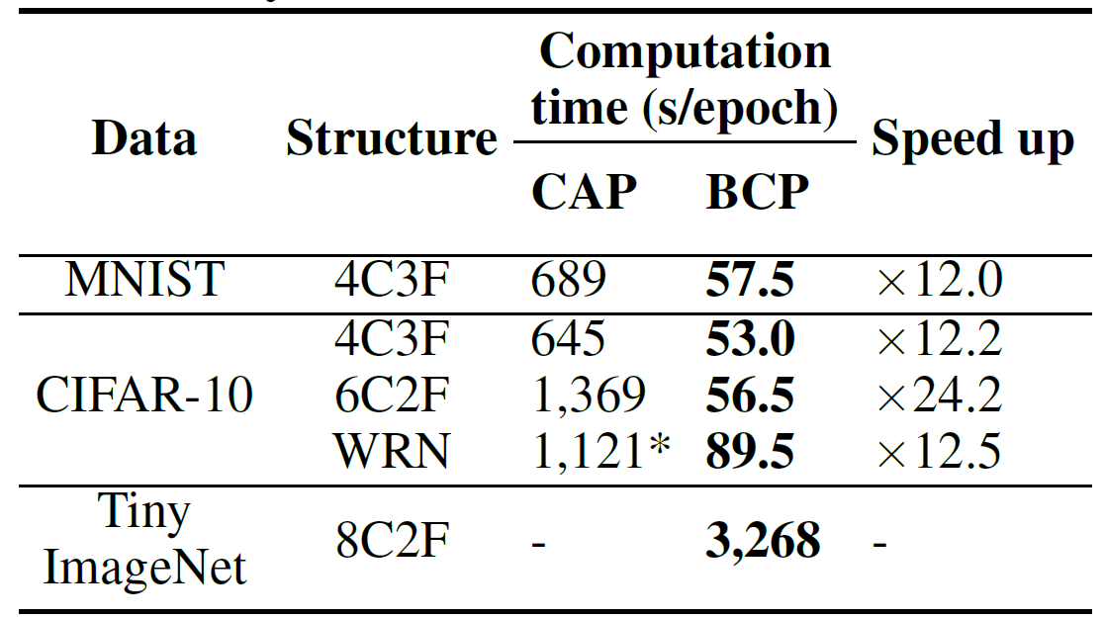
Lipschitz Constant
Experiment 3
Computation time compared to CAP [40].
BCP is over 12 times faster than CAP (*For WRN, CAP uses two GPUs because of the memory limit).
Table 1
Sungyoon Lee, Jaewook Lee, Saerom Park. Lipschitz-Certifiable Training with a Tight Outer Bound. NIPS. 2020.

Slide 21
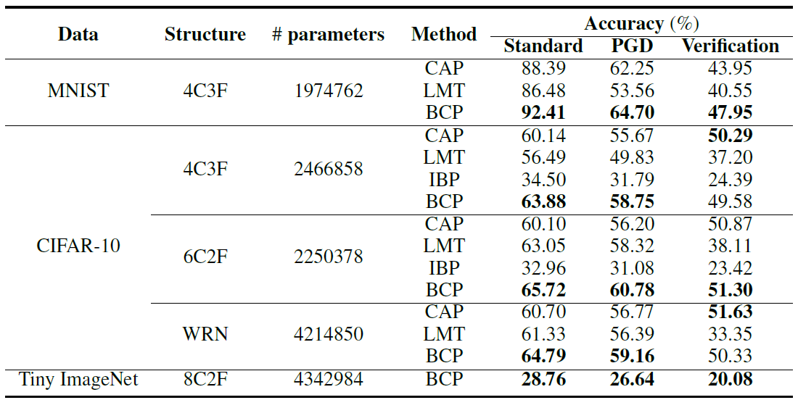
Lipschitz Constant
Experiment 4
Comparison to other verifiable training methods.
Best performances are highlighted in bold.
Table 2
Sungyoon Lee, Jaewook Lee, Saerom Park. Lipschitz-Certifiable Training with a Tight Outer Bound. NIPS. 2020.

Slide 22
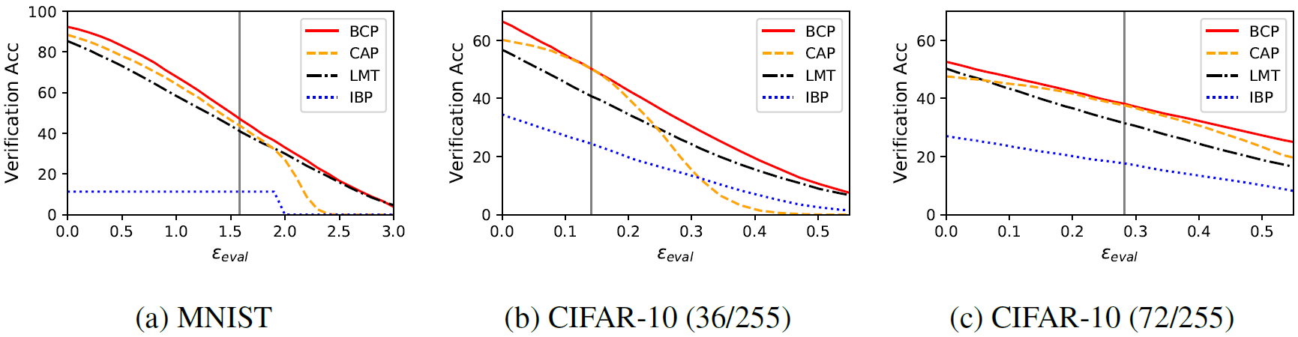
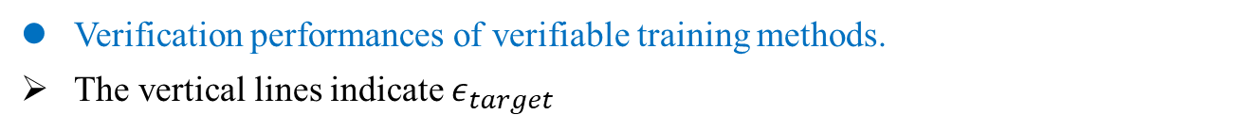
Lipschitz Constant
Experiment 5
Verification performances of verifiable training methods.
The vertical lines indicate $ε_{target}$
Figure 4
Sungyoon Lee, Jaewook Lee, Saerom Park. Lipschitz-Certifiable Training with a Tight Outer Bound. NIPS. 2020.

Slide 23

Lipschitz Constant
Conclusion
we propose a fast certifiable training with a tight outer bound.
我们提出了一种具有严格外部界限的快速可认证培训。
To obtain a tight outer bound, we propose BCP that efficiently computes box constraints which can tighten the outer bound.
为了获得紧密的外部边界，我们提出了 BCP，它可以有效地计算可以收紧外部边界的框约束。
Then, we train a certifiably robust model by minimizing the certificate loss based on the worst-translated logit over the tight outer bound.
我们通过基于紧外部边界上的最差转换 logit 最小化证书损失来训练一个可证明的鲁棒模型。
By doing so, we can build the first certifiable robust model on Tiny ImageNet under the $l_{2}$-perturbation.
我们可以在“$l_{2}$-perturbation”下在 Tiny ImageNet 上构建第一个可验证的鲁棒模型。
We hope that our method can serve as a strong benchmark for certifiable training on a large-scale dataset.
希望我们的方法可以作为大规模数据集上可认证培训的强大基准。
Sungyoon Lee, Jaewook Lee, Saerom Park. Lipschitz-Certifiable Training with a Tight Outer Bound. NIPS. 2020.

